Slide 1
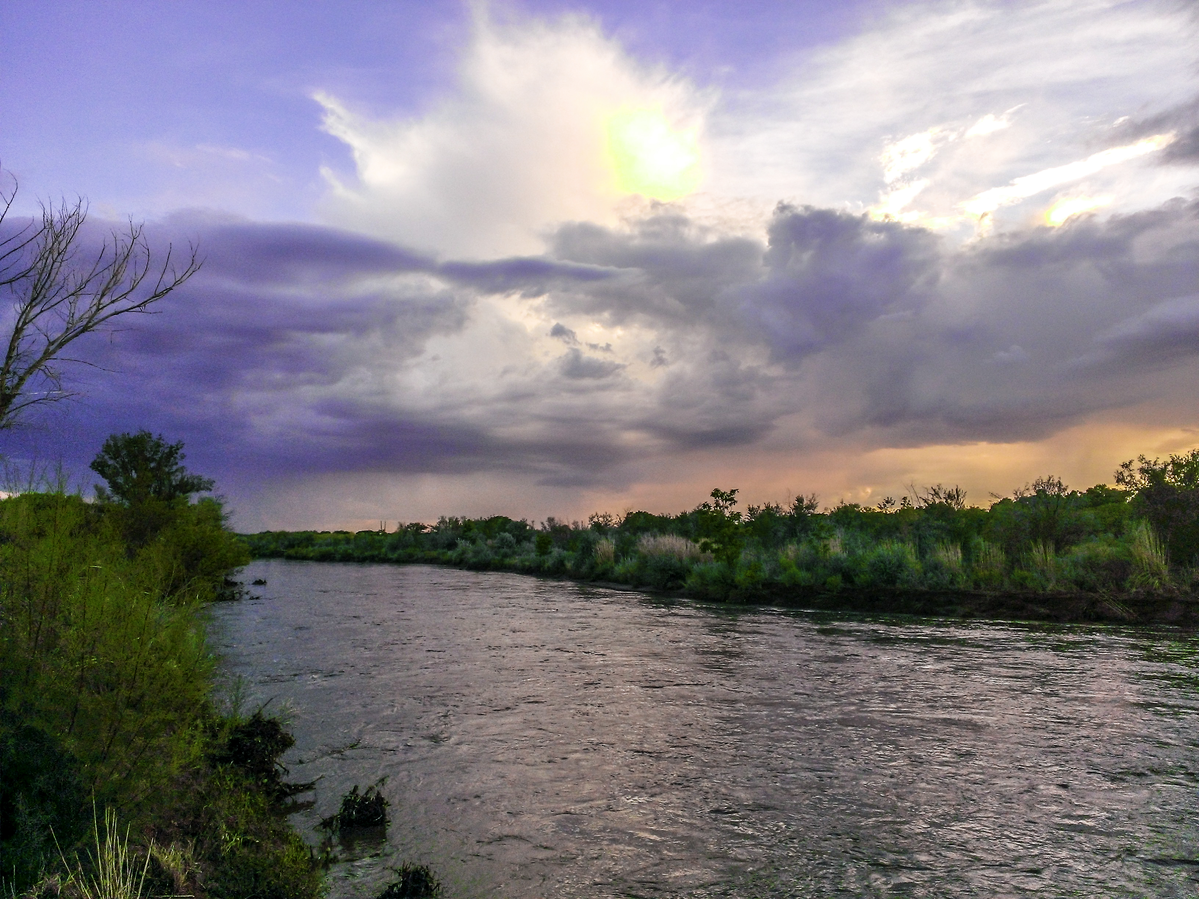
Rio Grande River
By: Faisal Eraiqat

Slide 2
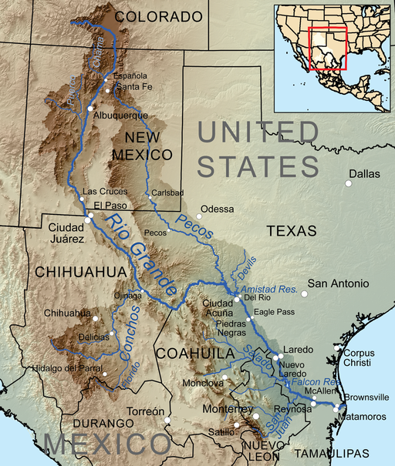
About The River
Borders Mexico and the U.S.
Around 3,051 km long
Ends in the Gulf of Mexico
Formed by streams in the mountains in the San Juan mountains

Slide 3
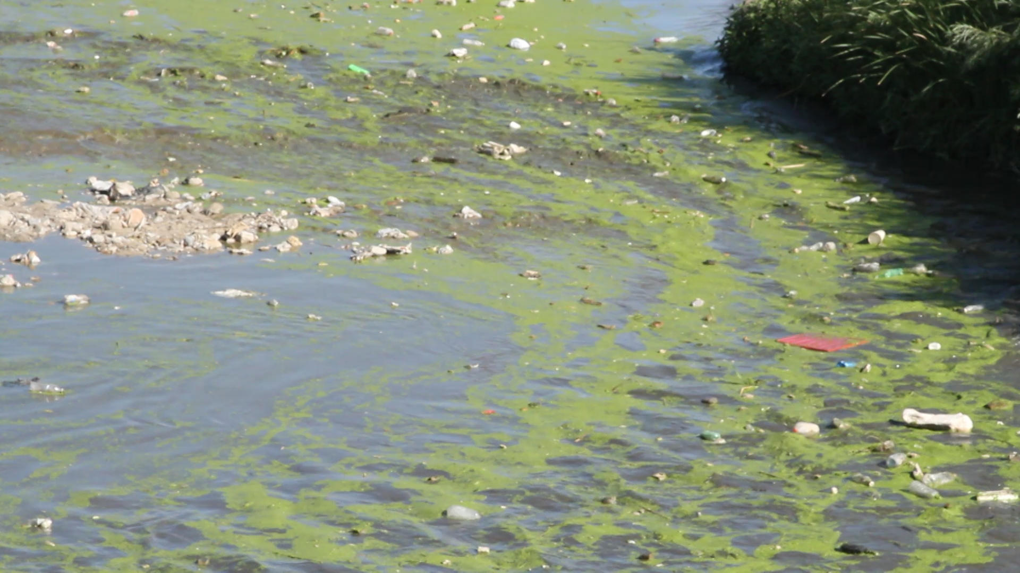
Issues
Mexico and U.S. dump garbage in it
Both struggling to clean it up
Pollution
Wildlife dying
Water contaminated

Slide 4
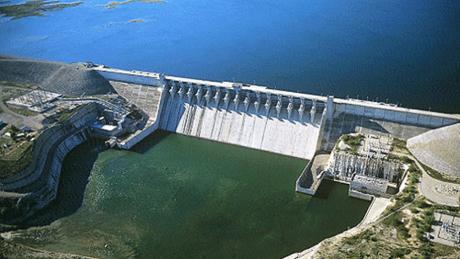
Changes
River has been changing
Getting smaller overtime
Water controlled to avoid floods
Dams built

Slide 5
Government Involvement
Organizations trying to clean up
Government focusing border disputes
Built dams and other means of controlling water flow

Slide 6
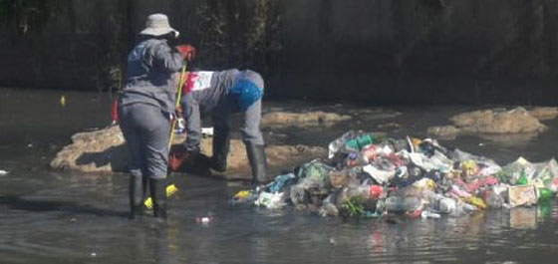
Human Contributions
Constantly pollute the waters
Rural area so lack of regulation
Public organizations working to clean up
Struggles due to lack of government support

